Slide 1
Number Theory and Cryptography Lecture 7
John P. Baugh, Ph.D. University of Michigan - Dearborn

Slide 2
Introduction
We shift gears a little and focus on number theory
Number theory primarily deals with prime numbers and interesting characteristics that they have
Also, relatively prime numbers (co-prime numbers) are discussed
Number theory has multiple areas of application
Cryptography is one of the most well-known and important
We discuss differences and uses for symmetric and asymmetric cryptography
We take a more thorough look at a very popular asymmetric cryptographic scheme, the Rivest-Shamir-Adleman (RSA) cryptosystem

Slide 3
Lecture 7 Contents
Introduction to Security and Cryptography
Symmetric key cryptosystems
Asymmetric (public) key cryptosystems
Number theoretical primitives
Primes, co-primes and congruence
Modular arithmetic properties
Modular arithmetic on large numbers
Fermat’s Little Theorem and the co-primality corollary
Euclid’s Algorithms for GCD
RSA Cryptosystem
Background information
Euler’s totient function
Simple examples

Slide 4
Introduction to Security and Cryptography
“There are two types of encryption – one that will prevent your sister from reading your diary, and one that will prevent your government.” – Bruce Schneier

Slide 5
Computer Security
Computer and network security involves many different aspects of providing a safe, reliable environment for computer and network users
The “big three” characteristics of a secure system are realized in the acronym CIA
Confidentiality
Integrity
Availability
Confidentiality is the property of keeping data secret between communicating parties
Integrity
Origin integrity (authentication): proof that information originated with a specific individual
Data integrity: data is free from tampering, and appears as it originated from the sender
Availability is the property in which resources are there (available) when you need them

Slide 6
Cryptography
Cryptography is one of the most important areas of computer science as used in business, especially e-commerce, and in transmission of sensitive data in general
It is an enabling feature of confidentiality and even integrity in secure systems
It involves processing data, converting it into an unintelligible form that no one can read (ideally) except the intended recipient(s) of that data
Conversion process
The cipher is the algorithm used for encryption (enciphering)
Unconverted data is called plaintext, and is encrypted, becoming ciphertext
To restore the original plaintext, the ciphertext is decrypted (deciphered)
Two major types:
Symmetric, or secret-key cryptography
Asymmetric, or public-key cryptography

Slide 7
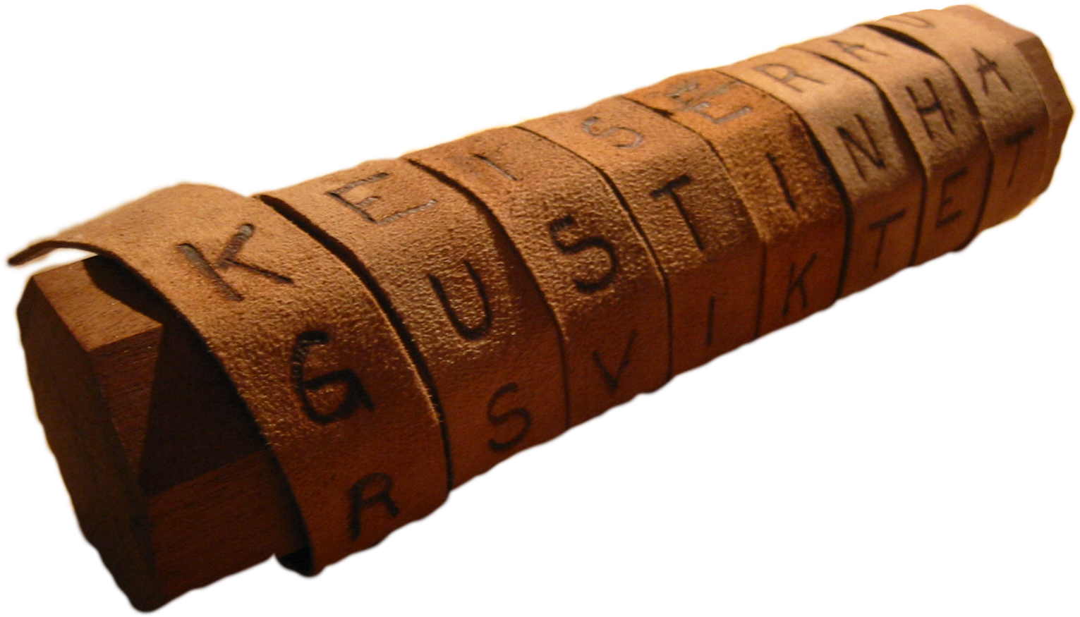
Symmetric Key Cryptography
As the name suggests, symmetric key cryptography involves two communicating parties with copies of the same key using it to convert their messages, and communicate over an insecure medium
Symmetric key encryption is ancient – it has been around for a couple thousand years
Often, symmetric key encryption was done with pen and paper (or their analogues) and is often called classical encryption
The ancient Greeks used the scytale (skih-tuh-lee) to encrypt messages

Slide 8
SKC: Substitution Cipher
The Caesar cipher, attributed to Gaius Julius Caesar, is an example of a substitution cipher where original characters in the plaintext are substituted with other characters to result in the ciphertext
Caesar used:
A key of 3
Encryption cipher: “left shift 3 characters”
Decryption algorithm: “right shift 3 characters”
It sounds (and is) incredibly simple by today’s standards, but it was quite effective in keeping data secret should a messenger be captured by the enemy

Slide 9
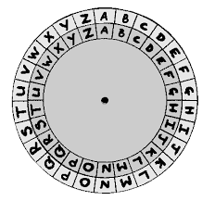
Caesar Cipher Example
Plaintext: hello
If we left shift the alphabet by 3 (the key)
Ciphertext: khoor
plaintext | a | b | c | d | e | f | g | h | … | z
ciphertext | d | e | f | g | h | i | j | k | … | c
Outer (larger) circle: plaintext
Inner (smaller) circle: ciphertext
Keep the large circle stationary, and move the inner circle to the left (counter-clockwise) for the substitution ciphertext alphabet
Caesar Shift Wheel

Slide 10
SKC: Transposition Cipher
Another symmetric cryptography technique is the transposition cipher, which involves shuffling letters within a message to perform the encryption
This is different from substitution, since substitution performs a complete, but consistent, replacement of letters
Once of the simplest forms of transposition is the rail-fence technique

Slide 11
Rail-Fence Technique
The key is the “number of rails”
It’s easier to see from an example, so let’s see one
Plaintext: meet me in the lobby
Key: 2 (so, 2 rows will be used)
Algorithm: put the message in a table with 2 rows in column major order
Column major ordering means we fill in one column at a time, as opposed to row major, which is one row at a time)
Then, the ciphertext is produced by reading the message in row major order:
memiteobetenhlby
m | e | m | i | t | e | o | b
e | t | e | n | h | l | b | y

Slide 12
Rail-Fence Decryption
Decryption is quite easy
The number of rails (in our case, 2) is the cryptographic key
Notice both parties use the same key, but different algorithms: symmetric key encryption!
You apply the algorithm in reverse:
Create table with 2 rows
Divide number of characters in ciphertext message by the number of rows to obtain the number of columns and take the ceiling (in our case, we have 16 characters and 2 rows, so ceiling(16/2) = 8
This creates a 2 x 8 table – fill in the characters of ciphertext in row major (left to right), and we read it off in column major since this restored the original encryption table
m | e | m | i | t | e | o | b
e | t | e | n | h | l | b | y
memiteobetenhlby

Slide 13
AES
The aforementioned techniques are very simple, but they illustrate principles used in encryption today
The Advanced Encryption Standard (AES) is a symmetric key encryption adopted by the US in 2002
The encryption breaks the message into blocks and uses the key to permute the bits of the message
Also, rows shift and columns are swapped
AES is very fast and remains secure as of this lecture

Slide 14


Asymmetric Key Encryption
Arguably one of the only “extreme” breakthroughs in cryptography in thousands of years, asymmetric cryptography was developed in the 1970s
Although it was being experimented with in British Intelligence earlier, Whitfield Diffie and Martin Hellman at Stanford are credited with developing it and publishing the work
Diffie and Hellman proposed the characteristics of a so-called “asymmetric key system” (public key system), largely for solving the purpose of key distribution
M. Hellman
W. Diffie

Slide 15
Asymmetric Key Encryption
A major problem with symmetric encryption is key distribution
If Alice and Bob want to communicate, they both have to have the correct key
If Alice just e-mails Bob the key, she might as well not use encryption since email is insecure
Alice and Bob could meet up or send via snail mail, but what if they’re far apart – this could take a long time
So, key distribution has long been a problem with symmetric key encryption
Diffie and Hellman envisioned a system where two keys existed: a public key and a private key
The public key could be distributed publicly, or at least without fear of problems if multiple people had it
The private keys would not be identical to the corresponding public key, but would be kept secret

Slide 16
AKE: Encryption and Decryption
If Alice wants to send Bob a message, M
She uses Bob’s public key, PU_{B} to encrypt the message, generating the ciphertext, C
That is: C = Encyption(PU_{B}, M)
Bob would then be the only person who could use his own private key PR_{B} to decrypt the ciphertext, C, restoring the plaintext, M
M = Decryption(PR_{B}, C)
This type of system would therefore, provide confidentiality
It could also be used to provide authenticity (origin integrity) by Alice using her private key to encrypt the original message or ciphertext, and then Bob (or anyone) could use her public key to decrypt it

Slide 17
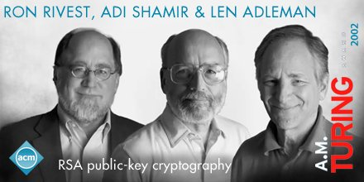
AKE: Putting it into action
While Diffie and Hellman made a great breakthrough by formalizing the characteristics of a “public key system”, they didn’t offer any algorithms
This would be done by another set of cryptographers at MIT
Ron Rivest
Adi Shamir
Len Adleman
They devised the RSA (Rivest-Shamir-Adleman) system at a Passover Seder in 1977, and published a paper on RSA in 1978
We will look at this more later…

Slide 18
Number Theory
“Mathematics is the queen of the sciences and number theory is the queen of mathematics. – Carl Friedrich Gauss

Slide 19
Primes and co-primes
Given any integer p, we say that p is prime if and only if p is evenly divisible only by p and 1
Examples: 3, 5, 7, 11, 13
Integers that are not prime are composite
Since they can be composed using other non-1, non-self integers
Examples: 2, 4, 6, 8, 9, 10, 12
Two integers, x and y are said to be co-prime (or, relatively prime) if 1 is the only common factor that they share
In order to be co-prime, the two integers x and y need not be prime
Examples include:
7 and 5 (both are prime, and co-prime)
9 and 34 (neither are prime, but they are co-prime)

Slide 20

Congruence
The concept of congruence is present in many areas of mathematics
It is a more precise definition than just “equals”
Congruence indicates equality of magnitude
In Geometry, for example, we can say that two angles are congruent
This doesn’t mean they are identical
In number theory, we are generally concerned with congruence modulo c
The value c is the modulus
Formally, we say, given a number c $≠$ 0:
a $≡$ b mod c (a is congruent to b modulo c)
If c evenly divides both a and b
That is, a is congruent to b, modulo c, or said another way, a and b produce the same remainder when divided by c
This is true iff (a – b) / c is an integer

Slide 21

Congruence: Example Set 1
Is 9 $≡$ 4 mod 3?
Using the definition that iff (a – b) / c is an integer:
a = 9, b = 4, c = 3
(9 – 4) / 3 = 5/3 → NOT an integer, so 9 and 4 are NOT congruent modulo 3
Is 9 $≡$ 6 mod 3?
(a – b) / c
(9 – 6) / 3 = (3) / 3 = 1 ← so they ARE congruent modulo 3
Is 24 $≡$ 10 mod 7?
(24 – 10) / 7 = (14)/7 = 2 ← so they ARE congruent modulo 7

Slide 22
Modular Arithmetic
The definition that you are generally given in beginning computer science courses of the result of a modulus operation is “the remainder”
This is a necessary part of the definition, but is a little insufficient
Specifically, the remainder (or residue) is a non-negative integer, left over after a division problem
The definition for modular arithmetic that you should memorize for test purposes is as follows:
In arithmetic modulo c we seek to express an integer x as follows:
x = cq + r
Where r must be non-negative
q is the quotient
r is the remainder
Examples will help greatly in understanding this, and other concepts in number theory

Slide 23
Modular Arithmetic: Example 1
What is the remainder of the following?
57 mod 12
Don’t just use your “intuitive” definition → identify and fill in the values – this will help later
Recall, we seek to find the remainder, r, when taking x mod c
x = qc + r
x = 57, c = 12 so let’s fill that in:
x = qc + r 57 = 12q + r
Now, figure out how many 12’s fit into 57. Result is 4 → (4 * 12 = 48)
57 = 12(4) + r = 48 + r
r = 9, since this is the non-zero remainder

Slide 24
Modular Arithmetic: Example 2
What is the remainder of the following?
26 mod 4
Don’t just use your “intuitive” definition → identify and fill in the values – this will help later
Recall, we seek to find the remainder, r, when taking x mod c
x = qc + r
x = 26, c = 4 so let’s fill that in:
x = qc + r 26 = 4q + r
Now, figure out how many 4’s fit into 26. Result is 6 → (4 * 6 = 24)
26 = 4(6) + r = 24 + r
r = 2, since this is the non-zero remainder

Slide 25
Modular Arithmetic: Example 3
What is the remainder of the following?
-26 mod 4
Don’t just use your “intuitive” definition → identify and fill in the values – this will help later
Recall, we seek to find the remainder, r, when taking x mod c
x = qc + r
x = -26, c = 4 so let’s fill that in:
x = qc + r -26 = 4q + r
You might be tempted to say q = -6, and then that’s -24, so r = -2, right? WRONG. The value of r must be non-negative
So, for negative modulus, you “overshoot” the x value with something more negative than it, and then “come back toward 0 a bit” using a positive r, so:
-26 = 4(-7) + r
-26 = -28 + 2, so r = 2

Slide 26
Class Exercise 1: Modulus
What is the remainder of the following?
-57 mod 12

Slide 27
Class Exercise 1: Modulus (SOLUTION)
What is the remainder of the following?
-57 mod 12
x = -57, c = 12, so:
x = qc + r -57 = 12q + r
Ask, “What do we multiply 12 by to get a number more negative than -57?
The answer is -6, since 12 * -6 = -60, which is the first multiple of 12 that’s more negative than -57
So:
-57 = 12(-6) + r = -60 + r
Use the r to make the -60 “come back” toward 0, to make it -57.
So, r = 3, since -60 + 3 = -57

Slide 28
Class Exercise 2: Modulus
What is the remainder of the following?
-63 mod 17

Slide 29
Class Exercise 2: Modulus (SOLUTION)
What is the remainder of the following?
-63 mod 17
x = -63, c = 17, so:
x = qc + r -63 = 17q + r
Ask, “What do we multiply 17 by to get a number more negative than -63?
The answer is -4, since 17 * -4 = -68, which is the first multiple of 17 that’s more negative than -63
So:
-63 = 17(-4) + r = -68 + r
Use the r to make the -68 “come back” toward 0, to make it -63.
So, r = 5, since -68 + 5 = -63

Slide 30
Modular Product Theorem
Often, we’re asked to find modulus of incredibly large numbers
The following theorem can help us break the problem into more manageable parts
Theorem 1.4.1 (Elenbogen/Baugh)
(a * b) (mod c) = [(a mod c) * (b mod c)] (mod c)

Slide 31
Modular Product: Example 1
Compute (64 * 9 * 10 * 5) mod 7
Answer:
(64 mod 7 * 9 mod 7 * 10 mod 7 * 5 mod 7) mod 7
Note, 64 mod 7 can be reduced to (8 mod 7 * 8 mod 7), each of which is 1, so 1 * 1 = 1
The 9 mod 7 = 2
The 10 mod 7 = 3
The 5 mod 7 = 5
So, in total:
(1 * 1 * 2 * 3 * 5) mod 7 = 30 mod 7

Slide 32
Modular Product: Example 1
For practice, use our linear definition to solve for the remainder of the modulus we just arrived at: 30 mod 7
So, x = 30, and c = 7: x = qc + r 30 = 7q + r
Now, how many 7’s fit in 30? The answer is 4, since 4 * 7 = 28
So: 30 = 7(4) + r = 28 + r
So, clearly r = 2

Slide 33

Modular Product: Example 2
Find 343 mod 6
This is a reasonably big number, but let’s see if we can reduce it at all to smaller modulus expressions that yield maybe 1 or 2
Well, since c = 6, that is, we are taking 343 modulo 6, what small numbers modulo 6 yield say, a 1? 7 does, that is: 7 mod 6 = 1 (that is, 7 $≡$ 1 mod 6)
Is 343 a multiple of 7? In fact it is. And 7³ = 343
Now we’ve got ‘em!
343 mod 6 = (7³) mod 6 = (7 mod 6 * 7 mod 6 * 7 mod 6) mod 6 = (1 * 1 * 1) mod 6 = 1 mod 6 = 1

Slide 34
Modular Product: Example 3
Solve 2⁵⁰ mod 7
Wowzer! That’s a big number…
Don’t panic, we’ve got this
Is there any power of 2 we can pull out that we know, taken mod 7, leaves say a small number like 1? This would be great since 1 taken to any power is just 1!
Yes! 2³ mod 7 = 8 mod 7 = 1!
Maybe we can pull out all, or the majority of the powers of 2?
(2³)¹⁶ = 2⁴⁸, so that’s pretty close! What’s left? Well:
2⁵⁰ = 2⁴⁸ * 2²
[(2³ mod 7)¹⁶ * (2² mod 7)] mod 7
[(8 mod 7)¹⁶ * (4 mod 7)] mod 7
[(1)¹⁶ * 4] mod 7 ← That’s a huge simplification! Yay multiplication property!
4 mod 7
= 4
So, depending on your calculator, it might not be able to do 2⁵⁰ mod 7, but you can!

Slide 35
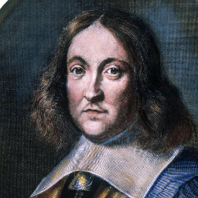

Fermat’s Little Theorem
Given a prime number, p, and any integer a, then:
(a^{p} – a) is evenly divisible by p
That is,
a^{p} $≡$ a mod p
Corollary:
If p is prime, and a is an integer, and a is co-prime to p, then:
(a^{p-1} – 1) is evenly divisible by p
That is
a^{p-1} $≡$ 1 mod p
That is, if we divide a^{p-1} by p, we will have a remainder of 1

Slide 36

Fermat’s Little Theorem: Ex. 1
Show that Fermat’s Little Theorem holds for co-primes p = 3, and a = 2
Recall, p must be prime, but a can be any integer
So:
a^{p} $≡$ a mod p
2³ $≡$ 2 mod 3?
Yes, since 8 mod 3 = 2, and 2 mod 3 = 2. Same remainder, so they’re congruent modulo 3
Fermat’s Little Theorem holds

Slide 37

Fermat’s LT Corollary: Example 1
Now, we must have p, a prime, and a, an integer (need not be prime), but a and p must be relatively prime (co-prime)
Let’s try a = 3, p = 7
a^{p-1} $≡$ 1 mod p
3⁷⁻¹ $≡$ 1 mod 7? = 3⁶ $≡$ 1 mod 7?
You can use properties of modulus to simplify: We know 3² = 9, and 9 mod 7 = 2, so:
[(3² mod 7)³] $≡$ 1 mod 7?
[(9 mod 7)³] = [(2)³] = 8 mod 7
So,
8 mod 7 = 1 mod 7 =1, so yes!
3⁶ $≡$ 1 mod 7

Slide 38
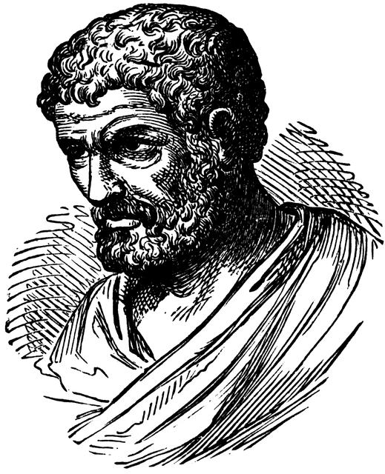
Euclid’s Algorithm (GCD)
The Greatest Common Divisor (GCD) of two integers is the largest positive integer that divides those two integers
E.g., GCD(8, 12) = 4, since 4 is the largest positive integer that divides both 8 and 12
Although a brute force technique is valid, it is not efficient
The Euclidean Algorithm states
The GCD(m, n) for positive integers m and n, where 0 < m < n is equal to GCD(n mod m, m).
When n mod m reaches 0, the algorithm ends and the result is m

Slide 39
GCD: Example 1
Q: Use Euclid’s algorithm to find GCD(20, 42)
A: We recall that Euclid’s algorithm says, under certain conditions stated previously, GCD(m, n) = GCD(n mod m, m)
So: GCD(20, 42) //m = 20, n = 42 = GCD(42 mod 20, 20) = GCD(2, 20) // Our new m = 2, n = 20. Our old 42 mod 20 isn’t 0, so keep // going
= GCD(20 mod 2, 2) = GCD(0, 2) //previous n mod m yielded 0, so 2 is the answer !

Slide 40
GCD: Example 2
Q: Use Euclid’s algorithm to find GCD(1180, 482)
A: We recall that Euclid’s algorithm says, under certain conditions stated previously, GCD(m, n) = GCD(n mod m, m)
Recall that we can write an integer as a linear expression, x = qc + r, from earlier!
So: GCD(1180, 482) //m = 1180, n = 482 = GCD(482, 1180) //swap them to make 0 < m < n, so m = 482, n = 1180 = GCD(1180 mod 482, 482) = GCD(216, 482) //1180 = 482(2) + 216, so remainder = 216 = GCD(482 mod 216, 216) //482 = 216(2) + 50, so remainder is 50 = GCD(50, 216) = GCD(216 mod 50, 50) //216 = 50(4) + 16, so remainder is 16 = GCD(16, 50) = GCD(50 mod 16, 16) //50 = 16(3) + 2, so remainder is 2 = GCD(2, 16) = GCD(16 mod 2, 2) //16 = 2(8) + 0 → since remainder is 0, answer is 2

Slide 41
Euclid’s Extended Algorithm
See book for details
The idea is that you perform the regular Euclidean GCD algorithm, but keep track of steps
You work your way back, and come up with an expression of the form: gcd(m, n) = mu + nv, where u and v are some integers
Ultimately, you want to be able to show that a gcd(m,n) can be written as a linear combination of the values m and n
This part is called Bezout’s (pronounced “bay zee”) Theorem

Slide 42
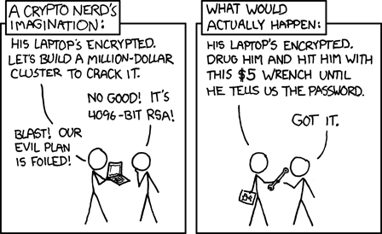
The RSA Cryptosystem

Slide 43
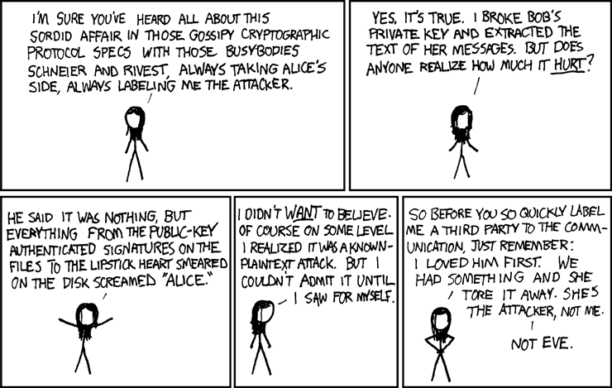
Eve weighs in on Alice and Bob

Slide 44
RSA
While Diffie and Hellman developed the concepts and requirements of a public key cryptosystem, they did not specify algorithms that met those requirements
Shortly after the publication of their paper, another group of cryptographers: Ron Rivest, Adi Shamir, and Len Adleman at MIT devised an algorithm to satisfy the requirements
Paper was published in 1978
RSA is a block ciper
This means the encryption is performed on blocks of plaintext
Like most public key cryptosystems, there are three distinct steps in RSA:
Key generation
Encryption
Decryption

Slide 45

RSA Setup
To allow others to securely communicate with her, Alice chooses two primes: p and q and from these, calculates 2 values:
n = pq
Φ(n) = (p-1)(q-1) //phi of n is called the “Euler totient function”
Then, Alice chooses an encryption key, e such that gcd(e, Φ(n) )= 1
That is, e and Φ(n) are co-prime
Alice calculates the decryption key, d, so that ed $≡$ 1 (mod Φ(n))
Alice makes the public key {n, e} known publicly and keeps her private key {d, p, q} secret

Slide 46

RSA Encryption
Bob wants to communicate with Alice
Bob looks up Alice’s public key, {n, e}
Bob writes his message, m, as m (mod n)
Bob computes the ciphertext, c $≡$ m^{e}(mod n)
Bob sends c to Alice

Slide 47

Example of RSA Setup
Alice selects the two primes, p = 17, q = 11
She calculates n = pq = (17)(11) = 187
She calculates Φ(n) = (p-1)(q-1) = (16)(10) = 160
She selects e such that e is relatively prime to Φ(n) = 160
We choose e = 7
Determine d such that de $≡$ 1 (mod 160) , d < 160
d = 23, since 23 * 7 = 161 = (1 * 160) + 1
You could have calculated d using Euclid’s algorithm
So, PU_{A} = {e, n} = {7, 187}
And PR_{A} = {d, n} = {23, 187}

Slide 48
Example of RSA Encryption
We know PU_{A} = {e, n} = {7, 187} and PR_{A} = {23, 187} → Bob wouldn’t know PR_{A}, just PU_{A}
So, if the message M = 88, we calculate ciphertext thusly:
C = Me mod n = 88⁷ mod 187 = 11
Bob sends the C = 11 to Alice

Slide 49

RSA Decryption
Alice receives c from Bob
Alice computes the original m $≡$c ^{d}(mod n)

Slide 50
Example of RSA Decryption
Alice receives the C = 11 from B
She computes, using her private key, PR_{A} = {d, n} = {23, 187}:
M = C^{d} (mod n) M = 11²³ mod 187 = 88
So, the original message is retrieved without loss, M = 88

Slide 51
Dispelling False Notions
Public key (asymmetric key) cryptography does not make secret key (symmetric key) cryptography obsolete
Nor, are they “more secure” than their symmetric key counterparts
The public key systems take vastly larger amounts of processing time than symmetric key systems
This wouldn’t be suitable for sending the billions of encrypted messages that are required in commerce, for example – it’s JUST TOO SLOW
So, what is it good for?
Public key systems are useful for solving the original problem they were targeting - key distribution!
You initiate communication using a public key system like RSA, and encrypt a symmetric key, which can then be used for subsequent communication (in a secret key system like AES)

Slide 52
Questions?
Questions?
Comments?
Remarks?

